Slide 1
Subqueries

Slide 2
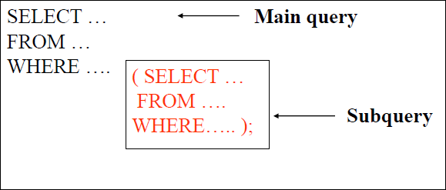
Subqueries
A subquery is a “query within a query”.
A SELECT statement nested within statement.
another
SELECT

Slide 3
Types of Subqueries
Single–row subqueries: Return only one row of result. They mark the usage of single row comparison operators, when used in WHERE conditions.
Multirow subqueries: Return more than one row of result. They make use of multiple row comparison operators like IN, ANY, ALL. There can be sub queries returning multiple columns also.
Multiple-column subqueries: returns more than one column.
Correlated Subqueries: Correlated subqueries depend on data provided by the outer query. This type of subquery also includes subqueries that use the EXISTS operator to test the existence of data rows satisfying specified criteria.

Slide 4
Single Row Subquery
List all employees whose salary is greater than that of SMITH.
Sol:
Find the salary of SMITH.
Select sal from emp where ename=‘SMITH’;
Use this salary to find all the employees.
select empno,ename from emp where sal > (select sal
from emp where ename=‘SMITH’);
•

Slide 5
Example-2
List all employees working in same department in which “SMITH” is working.
Sol: Find the department number of SMITH.
select deptno from emp where ename=‘SMITH’
Use this department number to find which employees are working.
select empno, ename from emp where deptno = (select
deptno from emp where ename=‘SMITH’ );
•

Slide 6
Example-3
List all employees working in “ACCOUNTING” department.
Sol:
Find the department number of department “ACCOUNTING”
Select deptno from dept where dname=‘ACCOUNTING’;
Use this department number to list all the employees working in same department.
Select empno, ename from emp where deptno = (Select deptno from dept where dname=‘ACCOUNTING’ );
•

Slide 7
Contd..
List the employees working under “KING”.
Find the employees whose department is same as “ALLEN” and salary is less than the salary of “BLAKE”.
To find the employee with highest salary.
To find the employees who earn more than the average salary of their company.
To find the departments whose average salary is more than
average salary of department 10.
Find the department with lowest average salary.

Slide 8
Contd..
Find the details of employee working in DALLAS.
Find who is getting the minimum salary in department 10.
Find the employees who are senior to SMITH.
Find out who are grade 5 Employees.
Who are the employees working under BLACK.
Find the manager being reported by maximum number of
employee.
Find the department number having highest number of employees.

Slide 9
Contd..
What will be the output ??
SELECT ename,sal, deptno FROM emp
WHERE deptno=( SELECT deptno FROM dept WHERE dname IN (‘SALES’,’ACCOUNTING’));
ERROR: single-row subquery returns more than one row

Slide 10
Multi-row Subqueries
Return more than one row
Uses a multiple-row comparison operators such as IN, ANY, ALL , EXISTS.
Most commonly used operator is IN

Slide 11
Example
List all the employees working in SALES and ACCOUNTING departments.
SELECT ename ,sal, deptno FROM emp
WHERE deptno IN ( SELECT deptno FROM dept WHERE dname IN (‘SALES’,’ACCOUNTING’));

Slide 12
Use of ANY operator
List the employees who are not in department 10 and whose salary is less than that of any employee of department 10.
SELECT ename ,sal, deptno FROM emp
WHERE sal < ANY ( SELECT sal FROM emp WHERE
deptno=10 ) AND deptno <> 10;

Slide 13
Use of ALL operator
List the employees who are not in department 10 and whose salary is less than the salary of all the employees of department 10.
SELECT ename ,sal, deptno FROM emp
WHERE sal < ALL ( SELECT sal FROM empWHERE
deptno=10 )AND deptno <> 10;

Slide 14
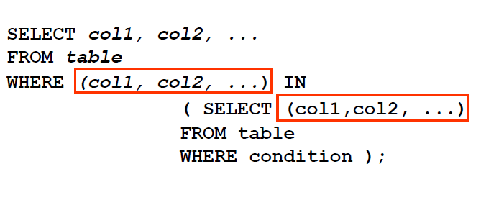
Multiple Column Sub Queries
A multiple-column subquery returns more than one column to the outer query.
Syntax:

Slide 15
Example:
Finds the highest-paid employee in each department.
SELECT deptno, ename, sal FROM emp
WHERE (deptno, sal) IN ( SELECT deptno, max(sal)
FROM emp GROUP BY deptno );
Finds the lowest-paid employee of each manager.
SELECT empno, ename, sal FROM emp
WHERE (mgr, sal) IN ( SELECT mgr, min(sal) FROM emp
GROUP BY mgr );

Slide 16
Correlated Subquery
A correlated subquery is one where the inner query depends on values provided by the outer query. This means that in a correlated subquery, the inner query is executed repeatedly, once for each row that might be selected by the outer query.
Correlated subqueries can produce result tables that answer complex management questions.

Slide 17
Contd..
Query to list employee name, department, and the highest salary in that department.
SELECT ename,deptno,
(SELECT max(sal) FROM emp e1
WHERE e1. deptno = e. deptno ) HSAL FROM emp e;

Slide 18
Example
List all employees whose salaries exceed their department average.
SELECT deptno, ename,sal FROM emp x
WHERE sal > ( SELECT AVG(sal) FROM emp
WHERE deptno = x.deptno );
For each row of the emp table, the parent query uses the correlated subquery to compute the average salary for members of the same department.

Slide 19
Using Exists Operator
Used with correlated subqueries to test for existence of rows in the result set of the subquery.
Returns TRUE, if the subquery returns at least one row.
Returns FALSE, if a subquery row value is not found.

Slide 20
Example
Find all employees who have at least one person reporting to them.
SELECT empno,ename FROM emp e1 WHERE EXISTS ( SELECT ‘X’ FROM emp WHERE mgrid= e1.empno);
The inner query doesn’t need to return any value.
The search in inner query doesn’t continue when at least one match is found.

Slide 21
Alternative Exists Operator
SELECT empno,ename FROM emp
WHERE empno IN ( SELECT mgr FROM emp WHERE mgr IS NOT NULL);

Slide 22
Example
Select deptno, dname from dept
where deptno IN ( select deptno from emp );
Write the above query using EXISTS.
Select deptno, dname from dept d
where EXISTS ( select ‘X’ from emp e where e.deptno = d.deptno);

